Slide 1
DOING DATA
SCIENCE
Case Study II
Onyeka Emmanuel
https://youtu.be/UwviuTrOraQ

Slide 2
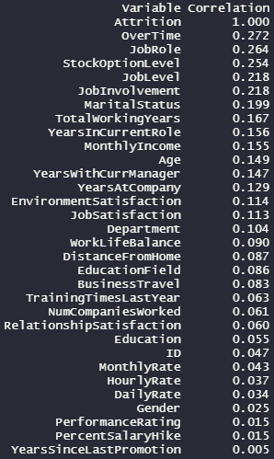
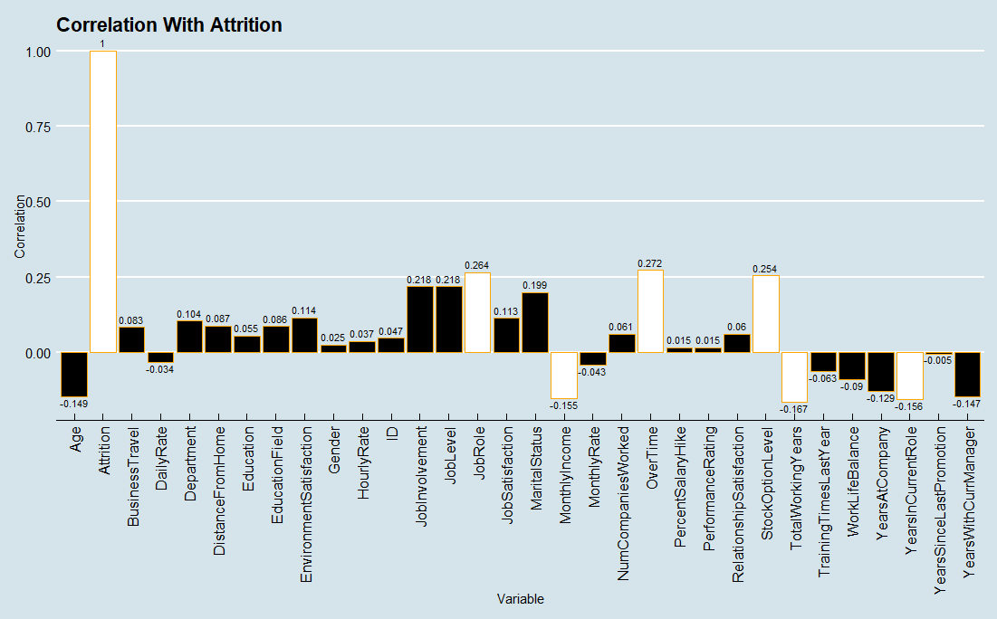
FACTORS CONTRIBUTING TO ATTRITION
Notes:
Using this graph we can see what states have higher and lower Number of breweries per state and this graph is good because it is quantifiable

Slide 3
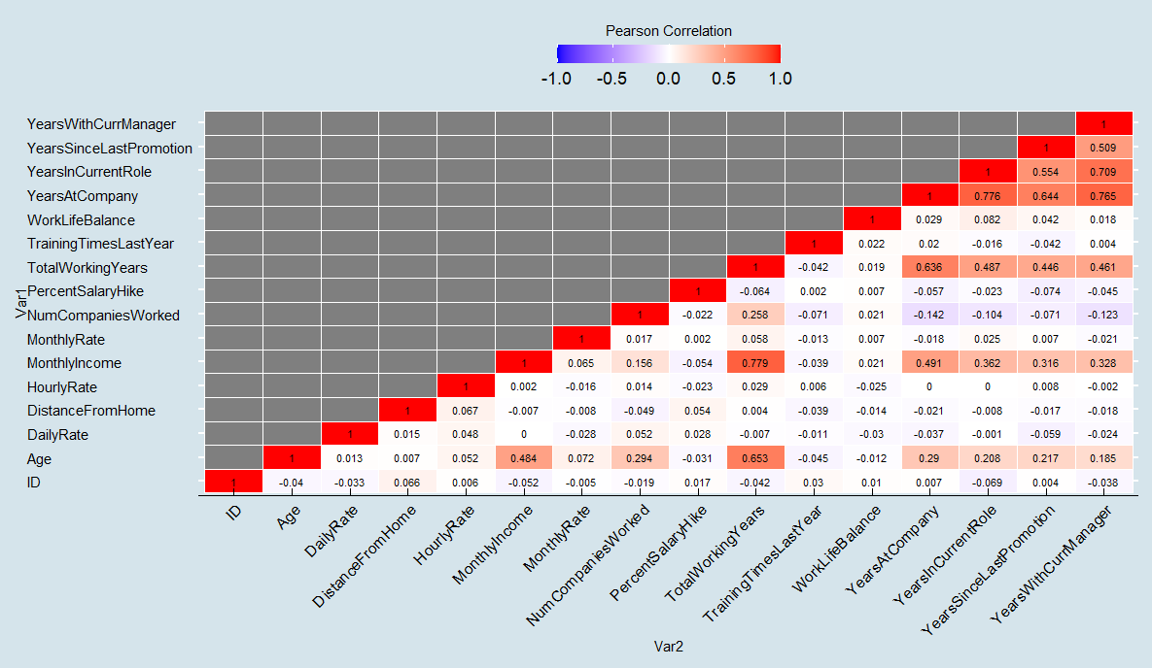
OTHER TRENDS
Notes:
Explain the Heat Map darker = more
We have more breweries in Colorado, California, Oregon, Michigan, Texas

Slide 4
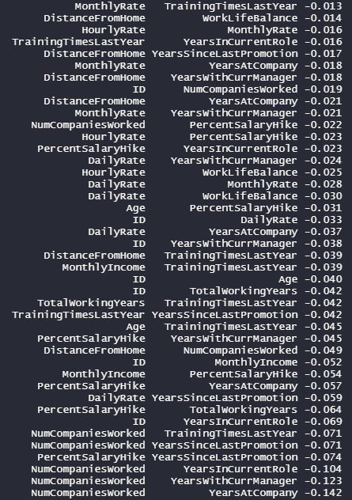
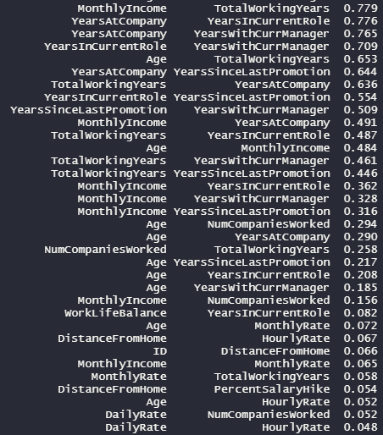
OTHER TRENDS Contd..
Notes:
These graphs show that we took out the missing values to tidy our data.
Using the common factor of Brewery ID we were able to link both Datasets by linking the beers with their corresponding Brewery

Slide 5
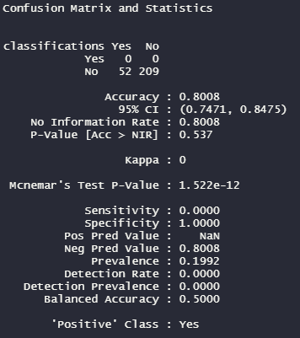
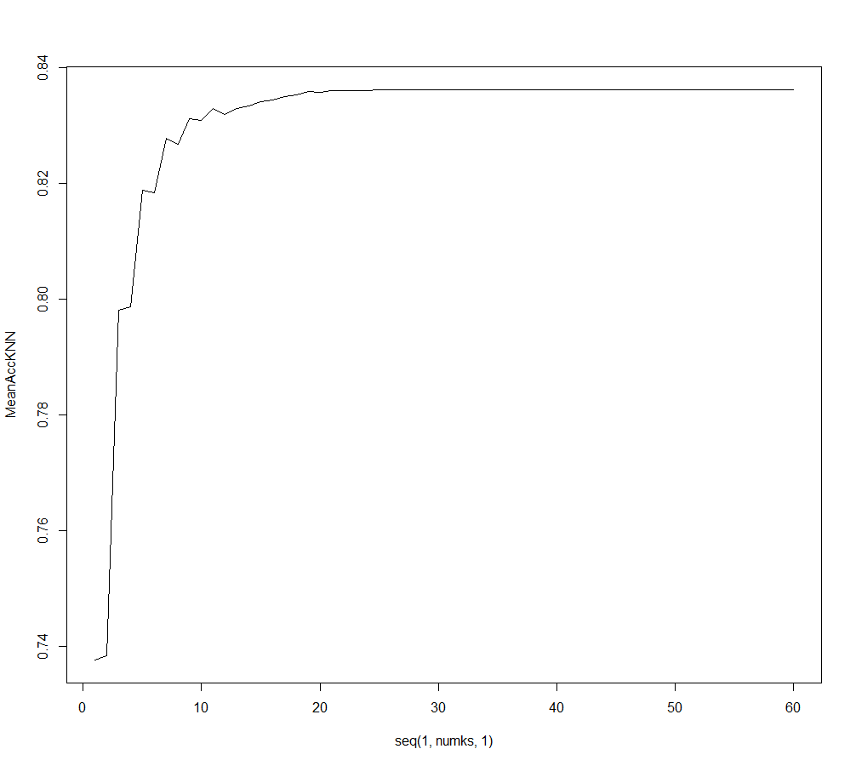
K - NEAREST NEIGHBORS (KNN)

Slide 6
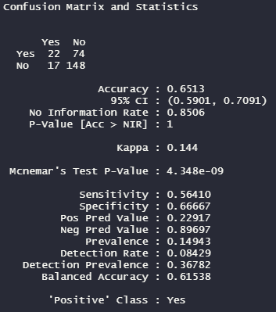
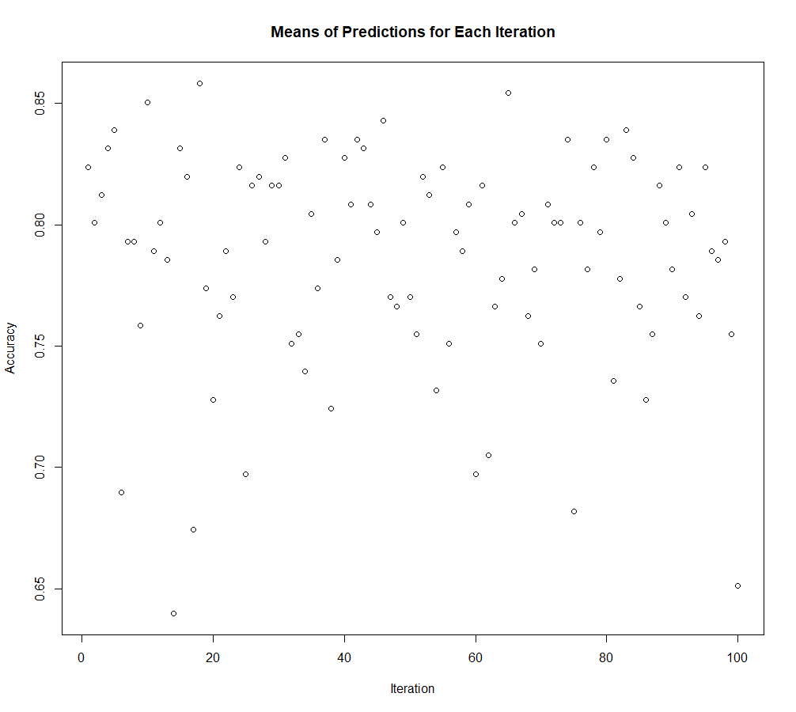

Naive Bayes

Slide 7
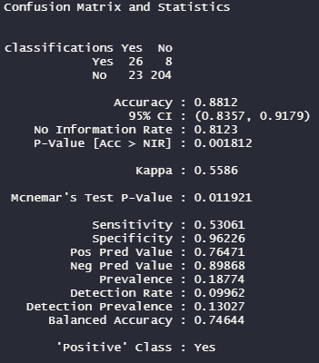
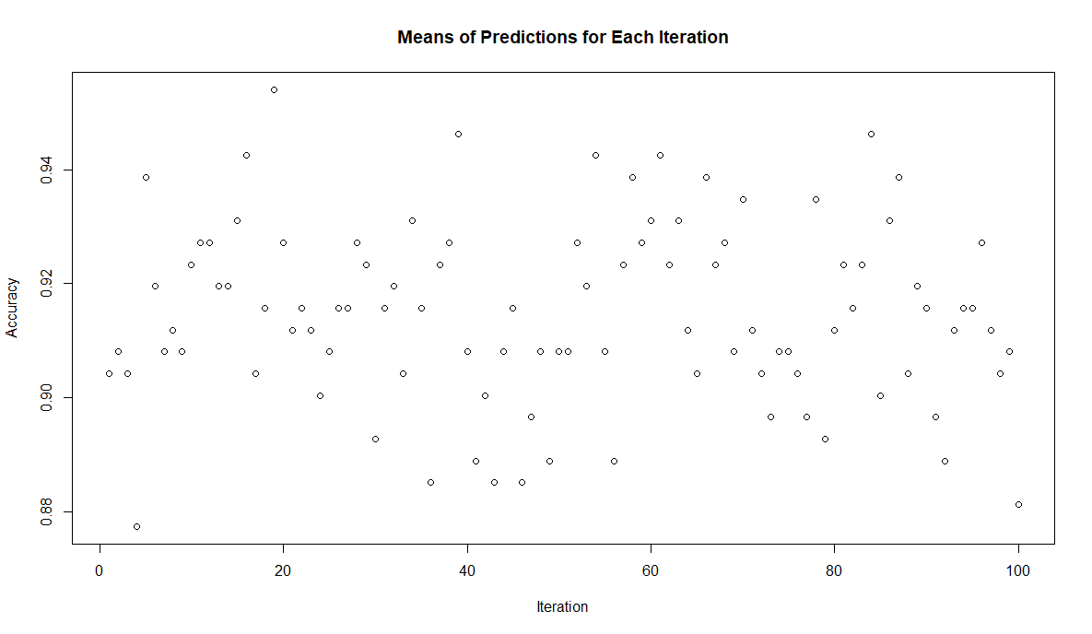

Logistic Regression
Notes:
Note: Belgian Style Quadrapel Ale is not in the cleaned dataset.

Slide 8
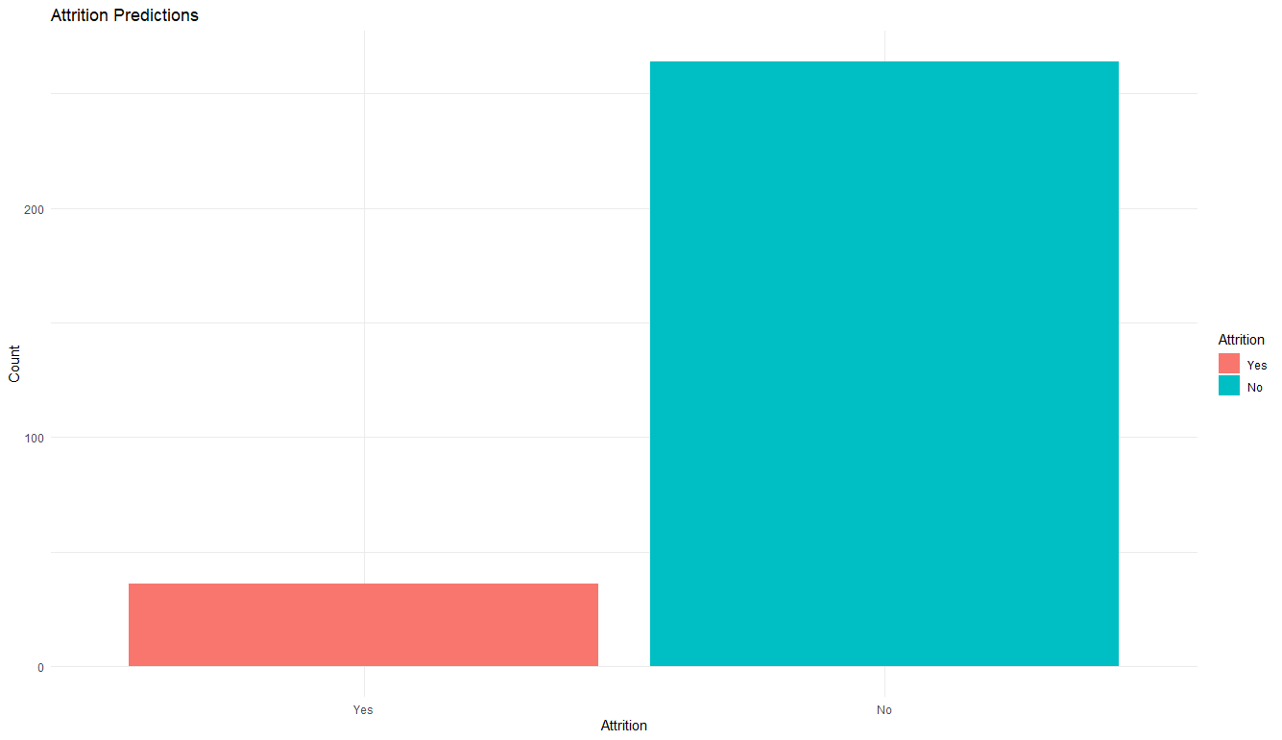
Attrition Predictions
Notes:
So we can see from the data that the median of the APV in beers in the US is around 0.056 and the minimum is 0.001 and the maximum is around 0.128

Slide 9
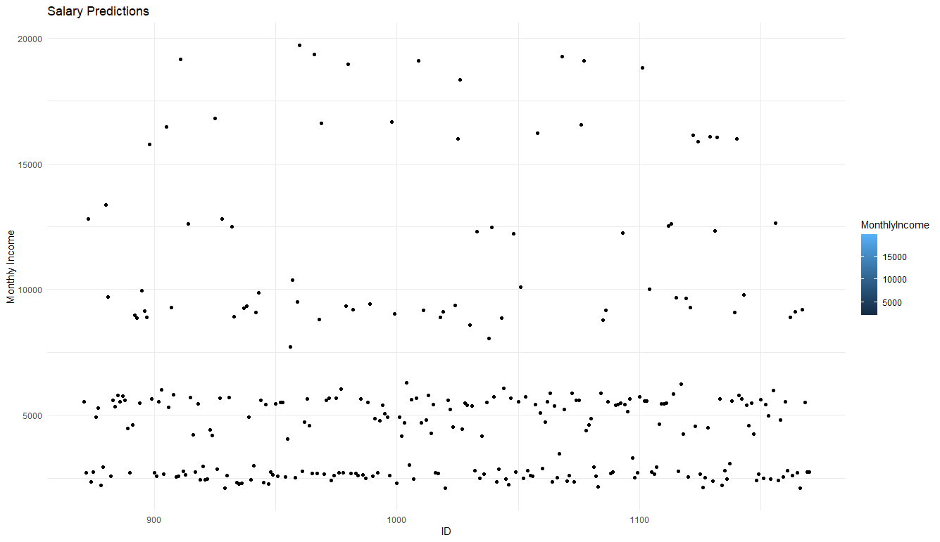
Salary Prediction

Slide 10
Thank You !

